Slide 1
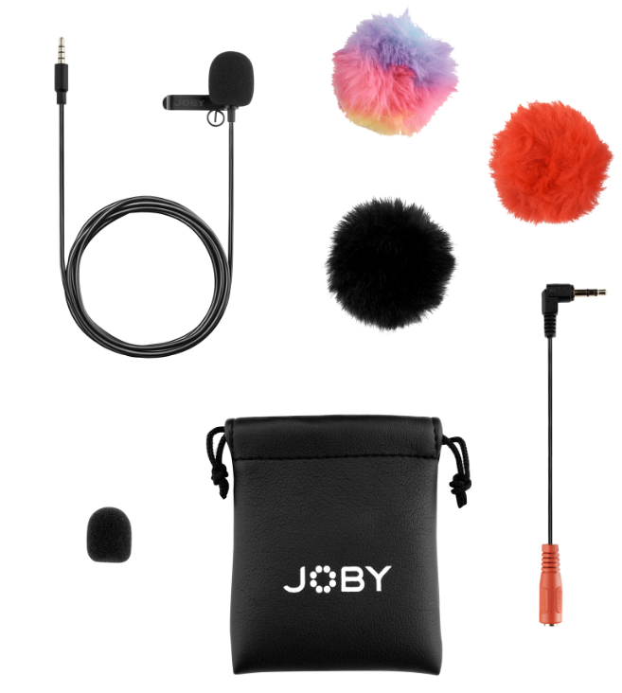
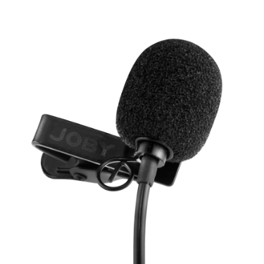
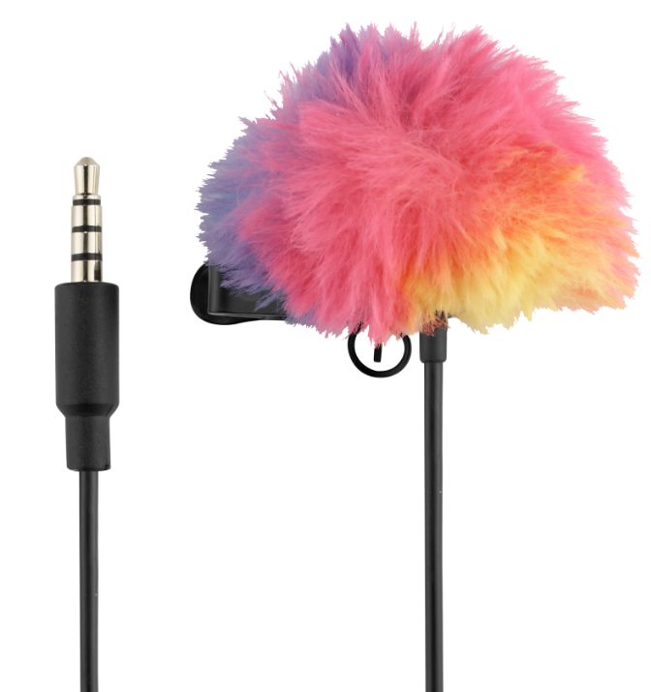
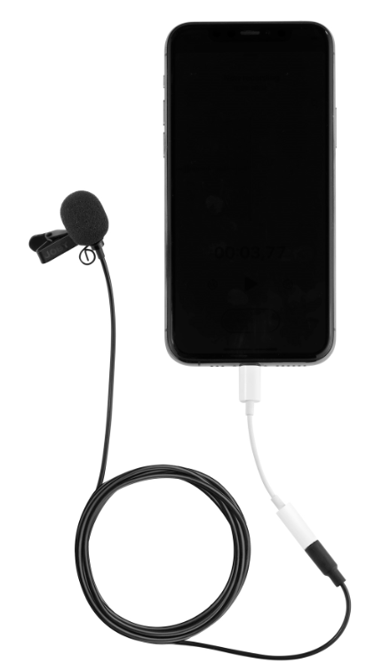
Wavo™ Lav Mobile
Lightweight mobile-friendly lavalier clip-on microphone for phones or cameras
JB01716–BWW
Sell Sheet
Built for quick and easy on-the-go vlogging vocals, the JOBY Wavo Lav Mobile is an omnidirectional lavalier microphone for phones or cameras. It’s simple to use, clip-on, and built to help capture awesome video content including vlogging, interviewing, live streaming, TikToking, and video chatting.
The Wavo Lav Mobile is stylish and minimal, yet has an impressive 5.9ft (1.8m) length for diverse applications. It also comes with three colorful fur windscreens for extra noise reduction and the ability to accessorize based on your mood and style!
Materials Foam, Synthetic fur, Aluminum, Brass, Plastic, PVC
Color
Black
Transducer: Polarized Condenser
Polar Pattern: Omnidirectional
Frequency Response: 25Hz – 20KHz (+/-2dB)
Signal to Noise Ratio: 66dB
Sensitivity: -34.5dB (18.8mV/Pa @94dB SPL)
Plug: 3.5mm TRRS and TRRS to TRS adapter
Max Level: 105dB
Dimensions: 70.87in x 0.31in x 0.31in (180cm x 0.8cm x 0.8cm)
Net Weight: 0.4lb (17g)
Manufacture Warranty One Year Warranty
Small But Mighty
A portable lavalier makes an ideal primary microphone which creators can take everywhere
Works as a great backup to shotgun mic when needed
Impressive length of 5.9ft (1.8m) for diverse applications
Clip It & Create
Simple plug-and-play operation
No apps or setup needed
Clean vocals free from background noise
Make A Statement
Three different fur windscreens to match your look and style: black, red, and rainbow
Mobile or Camera
Fitted with TRRS cable for easy mobile use (USB-C or lightning adapter may be required)
Supplied with TRRS to TRS adapter for out-of-box camera use

